Slide 1
Wireless Networking
Lecture 8 - Network Compression

Slide 2
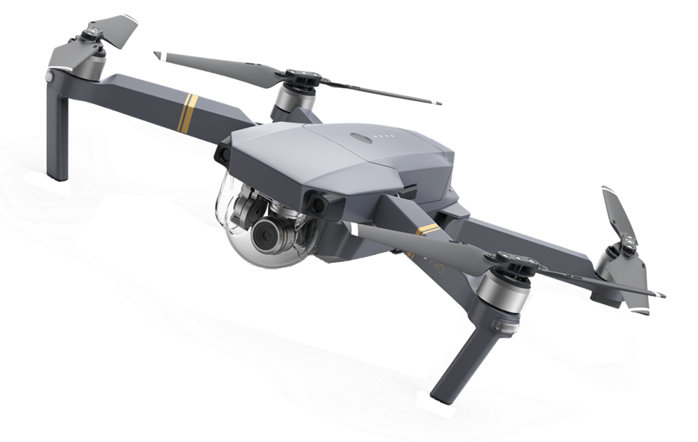


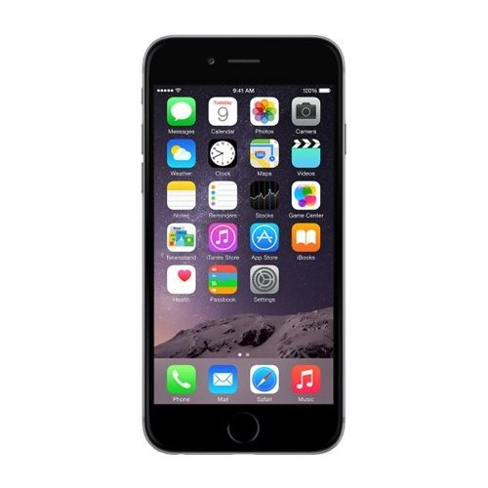
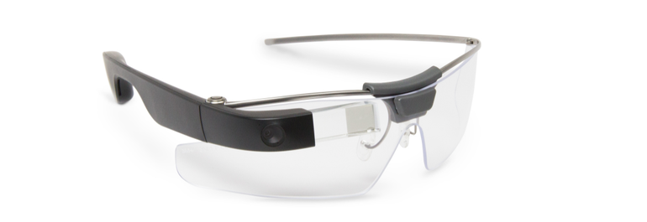
Resource-limited Devices
Limited memory space, limited computing power, etc.
Notes:
memory spaces, limited computing power

Slide 3
Contents
Network Pruning
Parameter Quantization
Knowledge Distillation
Architecture Design
Dynamic Computation
We will not talk about hard-ware solution today.

Slide 4
Network Pruning

Slide 5
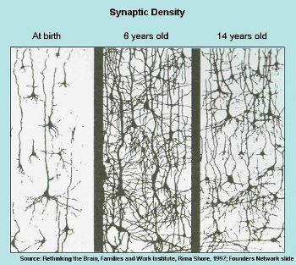
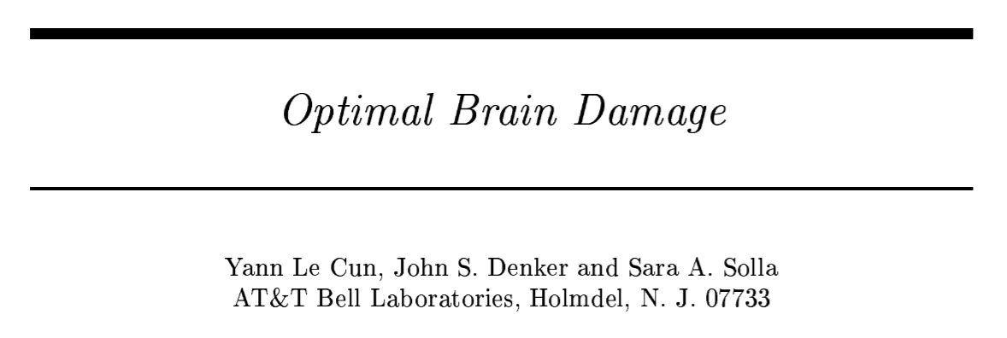
Network can be pruned
Networks are typically over-parameterized (there is significant redundant weights or neurons)
Prune them!

Slide 6
Network Pruning
Pre-trained
Network
large
Importance of a weight:
Evaluate the Importance
L1, L2 ……
Importance of a neuron:
Remove
the number of times it wasn’t zero on a given data set ……
smaller
After pruning, the accuracy will drop (hopefully not too much)
Fine-tune
Fine-tuning on training data for recover
no
Are you happy?
Don’t prune too much at once, or the network won’t recover.
yes
Smaller Network
Notes:
Pruning neural networks is an old idea going back to 1990 (with Yan Lecun’s optimal brain damage work) and before. The idea is that among the many parameters in the network, some are redundant and don’t contribute a lot to the output.
If you could rank the neurons in the network according to how much they contribute, you could then remove the low ranking neurons from the network, resulting in a smaller and faster network.
Getting faster/smaller networks is important for running these deep learning networks on mobile devices.
The ranking can be done according to the L1/L2 mean of neuron weights, their mean activations, the number of times a neuron wasn’t zero on some validation set, and other creative methods . After the pruning, the accuracy will drop (hopefully not too much if the ranking clever), and the network is usually trained more to recover.
If we prune too much at once, the network might be damaged so much it won’t be able to recover.
So in practice this is an iterative process - often called ‘Iterative Pruning’: Prune / Train / Repeat.

Slide 7

Why Pruning?
How about simply train a smaller network?
It is widely known that smaller network is more difficult to learn successfully.
Larger network is easier to optimize? https://www.youtube.com/watch?v=_VuWvQUMQVk
Lottery Ticket Hypothesis
https://arxiv.org/abs/1803.03635
Notes:
The Lottery Ticket Hypothesis: Finding Small, Trainable Neural Networks???

Slide 8

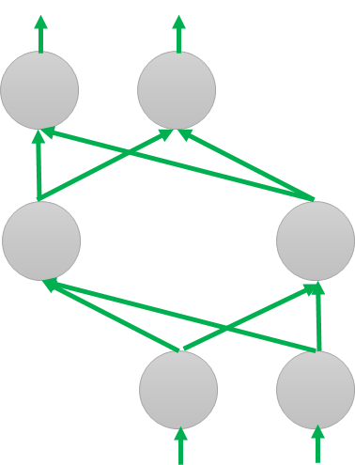
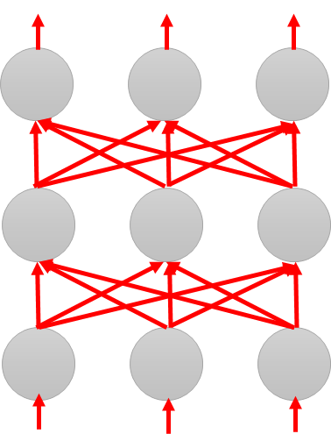
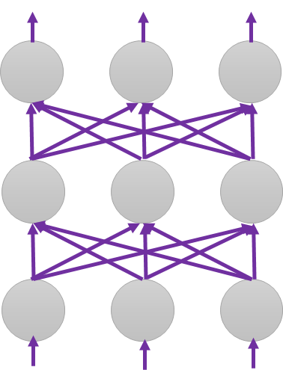
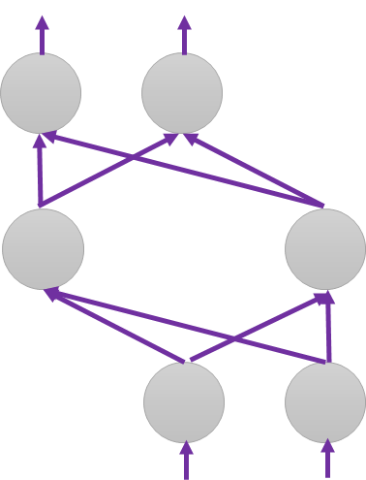
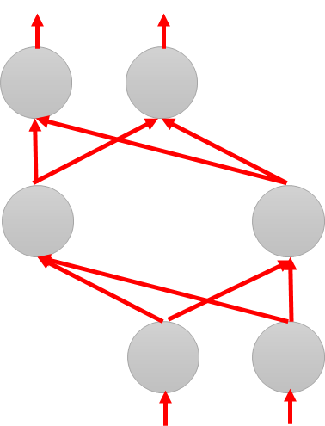

Why Pruning?
Lottery Ticket Hypothesis
Random init
Again
Original
Random init
Random init
Trained
Pruned
Random Init weights
Trained weight
Another random Init weights
Notes:
https://www.plurk.com/p/n27r0g

Slide 9
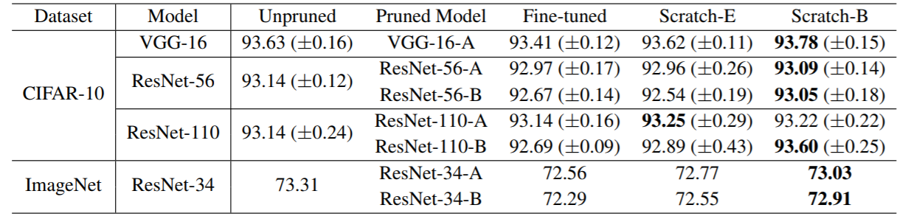
Why Pruning?
Rethinking the Value of Network Pruning
https://arxiv.org/abs/1810.05270
Real random initialization, not original random initialization in “Lottery Ticket Hypothesis”
Pruning algorithms could be seen as performing network architecture search

Slide 10
Network Pruning - Practical Issue
Weight pruning
The network architecture becomes irregular.
Prune some weights
Hard to implement, hard to speedup ……
Notes:
Hard to implement ... Can you implement by keras
Even you can implement
It is hard to speedup by GPU
Actually, use zero to replace -> just 自ｈｉ in paper
We will evaluate model size …..

Slide 11
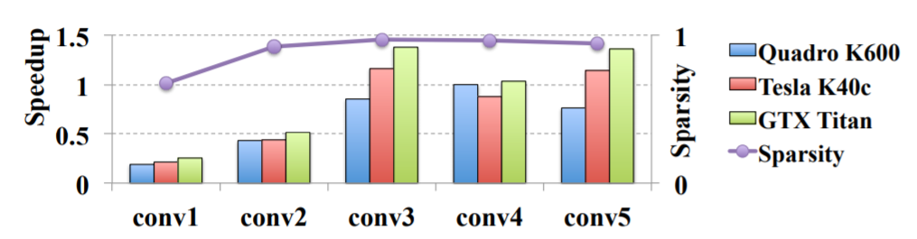
Network Pruning - Practical Issue
Weight pruning
https://arxiv.org/pdf/1608.03665.pdf
Notes:
nVIDIA Quadro K600 12GB 3D 繪圖卡
原廠三年保NVIDIA TESLA K40 12GB GPU K40 / K 40 CUDA 平行運算 ...

Slide 12
Network Pruning - Practical Issue
Neuron pruning
The network architecture is regular.
Prune some neurons
Easy to implement, easy to speedup ……
Notes:
Hard to implement ... Can you implement by keras
Even you can implement
It is hard to speedup by GPU
Actually, use zero to replace -> just 自ｈｉ in paper
We will evaluate model size …..

Slide 13
Parameter Quantization

Slide 14
Parameter Quantization
1. Using less bits to represent a value
2. Weight clustering
0.5 | 1.3 | 4.3 | -0.1
0.1 | -0.2 | -1.2 | 0.3
1.0 | 3.0 | -0.4 | 0.1
-0.5 | -0.1 | -3.4 | -5.0
weights in a network
Clustering

Slide 15
Parameter Quantization
1. Using less bits to represent a value
2. Weight clustering
3. Represent frequent clusters by less bits, represent rare clusters by more bits
e.g. Huffman encoding
Table
0.5 | 1.3 | 4.3 | -0.1
0.1 | -0.2 | -1.2 | 0.3
1.0 | 3.0 | -0.4 | 0.1
-0.5 | -0.1 | -3.4 | -5.0
 | -0.4
 | 0.4
 | 2.9
 | -4.2
weights in a network
Clustering
Only needs 2 bits
Notes:
極致就是 binary

Slide 16
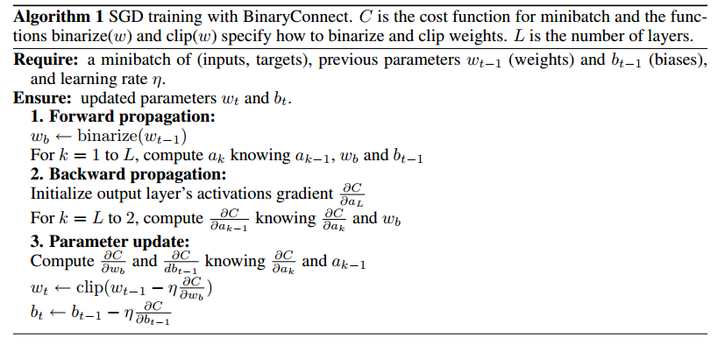
Binary Weights
Binary Connect: https://arxiv.org/abs/1511.00363
Binary Network:
https://arxiv.org/abs/1602.02830
XNOR-net:
https://arxiv.org/abs/1603.05279
Your weights are always +1 or -1
Notes:
Binary Connect

Slide 17
Binary Weights
Binary Connect: https://arxiv.org/abs/1511.00363
Binary Network:
https://arxiv.org/abs/1602.02830
XNOR-net:
https://arxiv.org/abs/1603.05279
Your weights are always +1 or -1
Binary Connect
network with binary weights
Negative gradient
network with real value weights
(compute on binary weights)
Update direction
(compute on real weights)
Notes:
Binary Connect

Slide 18
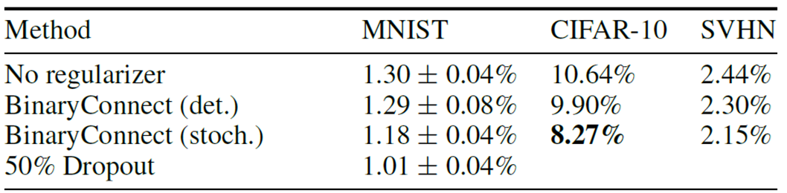
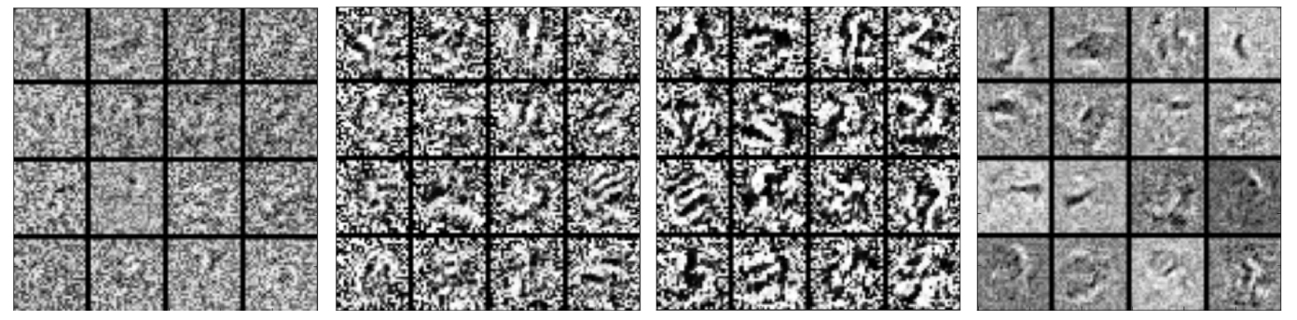
Binary Connect
https://arxiv.org/abs/1511.00363
Notes:
Lower: first layer of MLP on MNIST

Slide 19
Knowledge Distillation

Slide 20

Knowledge Distillation
Knowledge Distillation
https://arxiv.org/pdf/1503.02531.pdf
Do Deep Nets Really Need to be Deep?
https://arxiv.org/pdf/1312.6184.pdf
Cross-entropy minimization
Learning target
“1”: 0.7, “7”: 0.2. “9”: 0.1
?
Teacher Net
(Large)
Student Net
(Small)
Providing the information that “1” is similar to “7”

Slide 21
Knowledge Distillation
Knowledge Distillation
https://arxiv.org/pdf/1503.02531.pdf
Do Deep Nets Really Need to be Deep?
https://arxiv.org/pdf/1312.6184.pdf
Cross-entropy minimization
Learning target
“1”: 0.7, “7”: 0.2. “9”: 0.1
?
Average of a set of models
Model 1
Model 2
Student Net
(Small)
N Networks
Ensemble

Slide 22
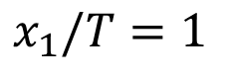
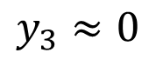
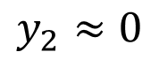
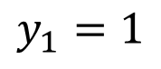
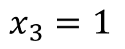
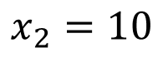
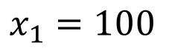
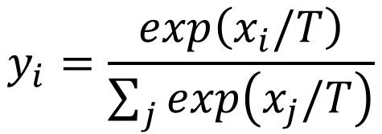
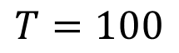
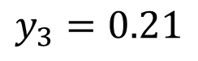
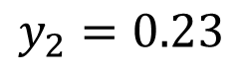
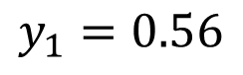
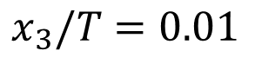
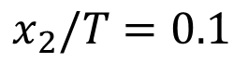
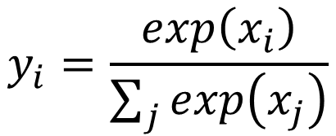
Knowledge Distillation
Temperature
$$y_{i}=\frac{exp\left(x_{i}\right)}{\sum_{j}{exp\left(x_{j}\right)}}$$
$$y_{i}=\frac{exp\left(x_{i}/T\right)}{\sum_{j}{exp\left(x_{j}/T\right)}}$$
$$T=100$$
$$x_{1}=100$$
$$y_{1}=1$$
$$x_{1}/T=1$$
$$y_{1}=0.56$$
$$x_{2}=10$$
$$y_{2}≈0$$
$$x_{2}/T=0.1$$
$$y_{2}=0.23$$
$$x_{3}=1$$
$$y_{3}≈0$$
$$x_{3}/T=0.01$$
$$y_{3}=0.21$$
Notes:
At least mentioned temperature …

Slide 23
Architecture Design

Slide 24
Low rank approximation
M
M
U
W
linear
K
V
N
N
N
K
N
W
U
V
K
M
≈
M
K < M,N
Less parameters

Slide 25
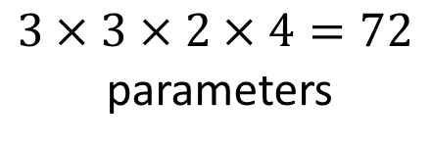
Review: Standard CNN
$$3×3×2×4=72$$
parameters
Input feature map
2 channels

Slide 26

Depthwise Separable Convolution
1. Depthwise Convolution
Filter number = Input channel number
Each filter only considers one channel.
The filters are $k×k$ matrices
There is no interaction between channels.

Slide 27
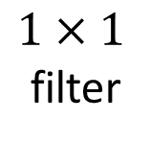
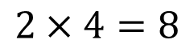
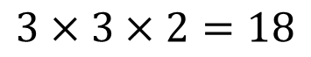
Depthwise Separable Convolution
1. Depthwise Convolution
$$3×3×2=18$$
2. Pointwise Convolution
$1×1$
filter
$$2×4=8$$

Slide 28
18 inputs
18 inputs
9 inputs
9 inputs

Slide 29
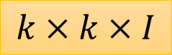
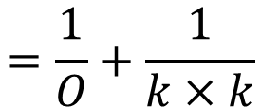
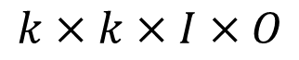
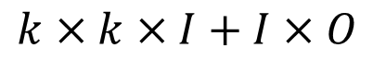
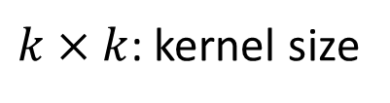

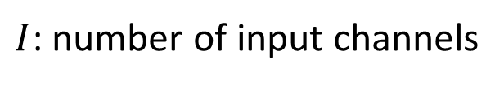
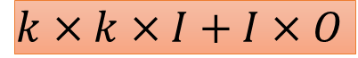
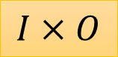
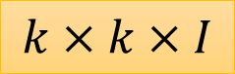
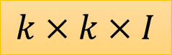
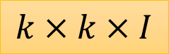

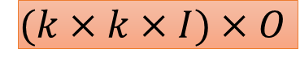
$I$: number of input channels
$$k×k×I$$
$O$: number of output channels
$$k×k×I$$
$k×k$: kernel size
$$k×k×I$$
$$k×k×I+I×O$$
$$k×k×I$$
$$k×k×I×O$$
$$I×O$$
$$=\frac{1}{O}+\frac{1}{k×k}$$
$$k×k×I$$
$$k×k×I+I×O$$
$$(k×k×I)×O$$

Slide 30
To learn more ……
SqueezeNet
https://arxiv.org/abs/1602.07360
MobileNet
https://arxiv.org/abs/1704.04861
ShuffleNet
https://arxiv.org/abs/1707.01083
Xception
https://arxiv.org/abs/1610.02357

Slide 31
Dynamic Computation

Slide 32
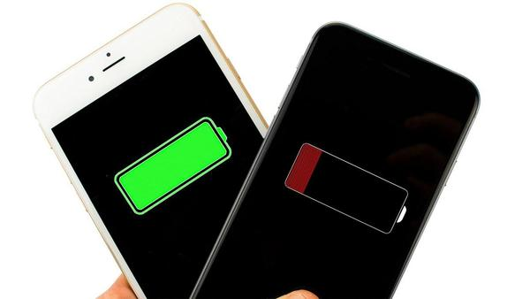

Dynamic Computation
Can network adjust the computation power it need?
if energy is sufficient , the goal is to achieve optimal accuracy.
if energy is drained, the goal is to achieve a reasonable accuracy with less power.

Slide 33
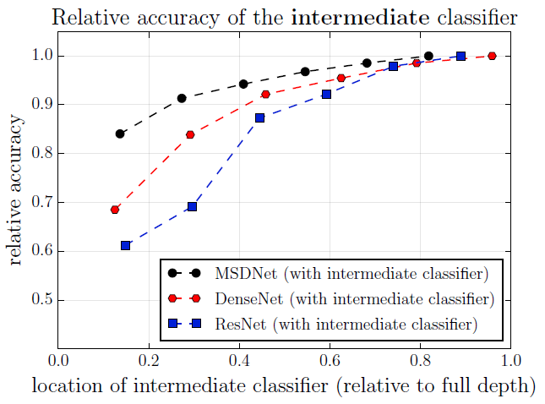
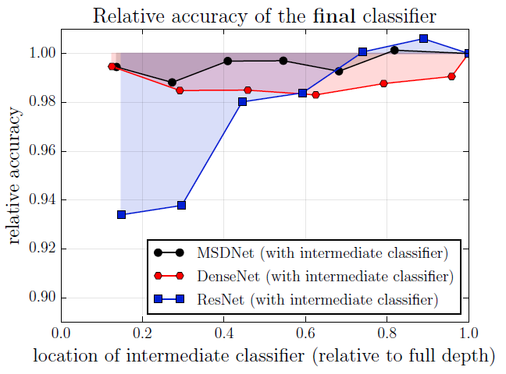
Possible Solutions
Layer
1
Layer
2
input
Classifier
Classifier
1. Train multiple classifiers
2. Classifiers at the intermedia layer
result
result
https://arxiv.org/abs/1703.09844

Slide 34
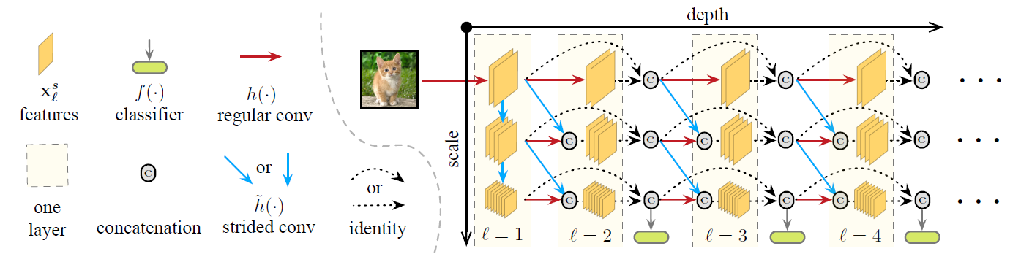

Multi-Scale Dense Networks
https://arxiv.org/abs/1703.09844

Slide 35
Wireless Networking
Lecture 9 - NN accelerator

Slide 36
Motivation

Slide 37

Map DNN to a Matrix Multiplication
Fully connected layer can be directly represented as matrix multiplication
(a) Matrix Vector multiplication is used when computing a single
output feature map from a single input feature map.
(b) Matrix
Multiplications is used when computing N output feature maps
from N input feature maps.

Slide 38
Map DNN to a Matrix Multiplication
Convolutional layer can be converted to Toeplitz Matrix
Filter
Input Fmap
Output Fmap
Filter
Input Fmap
Output Fmap
1 | 2
3 | 4
*
1 | 2 | 3
4 | 5 | 6
7 | 8 | 9
=
1 | 2
3 | 4
1 | 2 | 3 | 4
×
1 | 2 | 4 | 5
2 | 3 | 5 | 6
4 | 5 | 7 | 8
5 | 6 | 8 | 9
=
1 | 2 | 3 | 4
Convolution
Matrix Multiply (by Toeplitz Matrix)
Data is repeated

Slide 39
Popular DNN Models
Metrics | LeNet-5 | AlexNet | VGG-16 | GoogLeNet (v1) | ResNet-50 | EfficientNet-B4
Top-5 error (ImageNet) | n/a | 16.4 | 7.4 | 6.7 | 5.3 | 3.7*
Input Size | 28x28 | 227x227 | 224x224 | 224x224 | 224x224 | 380x380
# of CONV Layers | 2 | 5 | 16 | 21 (depth) | 49 | 96
# of Weights | 2.6k | 2.3M | 14.7M | 6.0M | 23.5M | 14M
# of MACs | 283k | 666M | 15.3G | 1.43G | 3.86G | 4.4G
# of FC layers | 2 | 3 | 3 | 1 | 1 | 65**
# of Weights | 58k | 58.6M | 124M | 1M | 2M | 4.9M
# of MACs | 58k | 58.6M | 124M | 1M | 2M | 4.9M
Total Weights | 60k | 61M | 138M | 7M | 25.5M | 19M
Total MACs | 341k | 724M | 15.5G | 1.43G | 3.9G | 4.4G
Reference | Lecun, PIEEE 1998 | Krizhevsky, NeurIPS 2012 | Simonyan, ICLR 2015 | Szegedy, CVPR 2015 | He, CVPR 2016 | Tan, ICML 2019
NeurIPS 2019
DNN models getting larger and deeper

Slide 40



Evolution of NN Accelerators
General HW(CPU&GPU)
optimazation for NN
Memory-centric Specific Hardware
SW/HW Co-design
Accelerator

Slide 41
CPU & GPU Platforms

Slide 42
CPU, GPU Libraries for Matrix Multiplication
Implementation: Matrix Multiplication (GEMM)
CPU: OpenBLAS, Intel MKL, etc
GPU: cuBLAS, cuDNN, etc
Library will note shape of the matrix multiply and select implementation optimized for that shape
Optimization usually involves proper tiling to memory hierarchy

Slide 43


Tiling Matrix Multiplication
Matrix multiplication tiled to fit in cache (i.e., on-chip memory) and computation ordered to maximize reuse of data in cache
Filters
CHW
Input fmaps
N
^{I}0,0 ^{I}0,1
^{I}1,0 ^{I}1,1
Output fmaps
N
Filters
CHW
Input fmaps
N
Output fmaps
N
N
N
^{F}0,0 | ^{F}0,1
^{F}1,0 | ^{F}1,1
F0,0I0,0 + F0,1I1,0 | F0,0I0,1 + F0,1I1,1
F1,0I0,0 + F1,1I1,0 | F1,0I0,1 + F1,1I1,1
F0,0I0,0
+
F0,1I1,0
F0,0I0,1
+
F0,1I1,1
CCHHW
CHW
×
W
=
×
=
M
F1,0I0,1
+
F1,1I1,1
M
M
F1,0I0,0
+
F1,1I1,0
Step 1
Step 2

Slide 44

Reduce Instruction Overhead
Perform more MACs per instruction
CPU: SIMD / Vector Instructions
e.g., Specialized Vector Neural Network Instructions (VNNI) fuse separate multiply and add instructions into single MAC instruction and avoid storing intermediate values in memory
GPU: SIMT / Tensor Instructions
e.g., New opcode Matrix Multiply Accumulate (HMMA) performs 64 MACs with Tensor Core
Perform more MACs per cycle without increasing memory bandwidth by adding support for reduced precision or increasing number of parallel MACs
e.g., If access 512 bits per cycle, can perform 64 8-bit MACs vs. 16 32-bit MACs
e.g., using multiple threads to compute in GPU
Tensor Core
Image Source: Nvidia

Slide 45
Memory-centric Specific Hardware

Slide 46

Roof line model
TPU [Jouppi, 2017]
-TPU Roofline
-K80 Roofline
★ HSW Roofline
★ LSTMO
★ LSTM1
★ MLP1
★ MLPO
★ CNNO
★ CNN1
▲ LSTMO
▲ LSTM1
▲ MLP1
▲ MLPO
▲ CNNO
▲ CNN1
★ LSTMO
★ LSTM1
☆ tpu
△ GPU K80
O CPU Haswell
4 more
Operational Intensity: Ops/weight byte (log scale)
Jouppi et al, TPU: In-Datacenter Performance Analysis of a Tensor Processing Unit, ISCA'17

Slide 47

Gap between real FLOP and peak FLOP: ---Memory Matters
TPU [Jouppi, 2017]
TPU Roofline
K80 Roofline
HSW Roofline
★
LSTMO
☆ tpu
△ GPU K80
O CPU Haswell
LSTM1
★
MLP1
★
MLPO
CNNO
★
CNN1
▲
LSTMO
▲
LSTM1
▲
MLP1
MLPO
CNNO
CNN1
• LSTMO
• LSTM1
4 more
Operational Intensity: Ops/weight byte (log scale)
Jouppi et al, TPU: In-Datacenter Performance Analysis of a Tensor Processing Unit, ISCA'17

Slide 48

Gap between real FLOP and peak FLOP: ---Memory Matters
TPU [Jouppi, 2017]
1 "About 35% of cycles are spent waiting for weights to load from memory into the matrix unit...”
TPU Roofline
K80 Roofline
HSW Roofline
LSTMO
☆ tpu
△ GPU K80
O CPU Haswell
LSTM1
CNNO
CNN1
▲ LSTMO
LSTM1
▲ MLP1
▲ MLPO
▲ CNNO
▲ CNN1
• LSTMO
LSTM1
4 more
Jouppi et al, TPU: In-Datacenter Performance Analysis of a Tensor Processing Unit, ISCA'17

Slide 49

Properties We Can Leverage
Operations exhibit high parallelism
→ high throughput possible
Memory Access is the Bottleneck
Memory Read MAC*
Memory Write
DRAM
filter weight fmap act partial sum
ALU
DRAM
updated partial sum
200x 1x
* multiply-and-accumulate
Worst Case: all memory R/W are DRAM accesses
Example: AlexNet has 724M MACs → 2896M DRAM accesses required

Slide 50
Local memory to reduce memory access
Memory Read
MAC*
Memory Write
DRAM
Mem
ALU
Mem
DRAM
* multiply-and-accumulate
Extra levels of local memory hierarchy
smaller but faster and more energy-efficient
CPU and GPU are also used

Slide 51
Leverage parallelism for higher performance
Memory Read
MAC*
Memory Write
DRAM
Mem
ALU
Mem
DRAM
ALU
......
ALU
CPU (multi-core) and GPU(tensors) are also used

Slide 52
Leverage parallelism for data reuse
Memory Read
MAC*
Memory Write
DRAM
Mem
ALU
Mem
DRAM
ALU
......
ALU

Slide 53

Highly-Parallel Compute Paradigms
31
Temporal Architecture (SIMD/SIMT)
Spatial Architecture (Dataflow Processing)
Memory Hierarchy
Memory Hierarchy
Register File
ALU
ALU
ALU
ALU
ALU
ALU
ALU
ALU
ALU
ALU
ALU
ALU
ALU
ALU
ALU
ALU
ALU
ALU
ALU
ALU
ALU
ALU
ALU
ALU
ALU
ALU
ALU
ALU
Control
ALU
ALU
ALU
ALU

Slide 54

Advantages of Spatial Architecture
32
Temporal Architecture
(SIMD/SIMT)
Memory Hierarchy Register File
ALU ALU ALU ALU ALU ALU ALU ALU ALU ALU ALU ALU ALU ALU ALU ALU
Control
Spatial Architecture (Dataflow Processing)
Eﬃcient Data Reuse
Distributed local storage (RF)
Memory Hierarchy
ALU
ALU
ALU
ALU
Inter-PE Communication
Sharing among regions of PEs
ALU
ALU
ALU
ALU
Processing Element (PE)
ALU
ALU
ALU
ALU
0.5 – 1.0 kB
Reg File
ALU
ALU
ALU
ALU
Control

Slide 55





















Data Movement is Expensive
35
Off-Chip DRAM
Accelerator
PE
PE
Processing Engine
Global Buffer
PE
=
PE
ALU
ALU
Data Movement Energy Cost
DRAM
ALU
200×
Buffer
ALU
6×
PE
ALU
2×
RF
ALU
1×
ALU
1× (Reference)
Maximize data reuse at lower levels of hierarchy

Slide 56
How to Map the Dataﬂow?
33
Spatial Architecture (Dataflow Processing)
CNN Convolution
Memory Hierarchy
partial sums
?
ALU
ALU
ALU
ALU
pixels weights
ALU
ALU
ALU
ALU
ALU
ALU
ALU
ALU
Goal: Increase reuse of input data (weights and pixels) and local partial sums accumulation
ALU
ALU
ALU
ALU

Slide 57
Properties We Can Leverage
30
Input data reuse opportunities (up to 500x)
→ exploit low-cost memory
Filters
Images
Image Image
1
Filter
Filter
1
2
2
Convolutional Reuse
Image Reuse
Filter Reuse
(pixels, weights)
(pixels)
(weights)

Slide 58


Weight Stationary (WS)
6
Global Buffer
Psum
Pixel
W0
W1
W2
W3
W4
W5
W6
W7
PE
Weight
Minimize weight read energy consumption
− maximize convolutional and filter reuse of weights
Examples: [Chakradhar, ISCA 2010] [Park, ISSCC 2015]
[nn-X (NeuFlow), CVPRW 2014] [Origami, GLSVLSI 2015]
TPU [Jouppi, ISCA 2017], NVDLA

Slide 59

TPU: Dataflow

Slide 60
Input Stationary (IS)
[Chen, ISCA 2016]
Global Buffer
Weight Psum
I1 I2 I3 I4 I5 I6 I7 I8
Act
PE
Minimize activation read energy consumption
− maximize convolutional and fmap reuse of activations
Unicast weights and accumulate partial sums spatially across the PE array
• Example: [SCNN, ISCA 2017]

Slide 61
Output Stationary (OS)
37
Global Buffer
Pixel Weight
P7
P0
P1
P2
P3
P4
P5
P6
PE
Psum
Minimize partial sum R/W energy consumption
− maximize local accumulation
Examples:
[Gupta, ICML 2015]
[Peemen, ICCD 2013]
[ShiDianNao, ISCA 2015]

Slide 62



Row Stationary: Energy-eﬃcient Dataﬂow
39
Input Image
Filter Output Image
*
=
[Chen, ISCA 2016]

Slide 63
1D Row Convolution in PE
40
Input Image
Filter
a | b | c | d | e
Partial Sums
a | b | c
*
a | b | c
=
Reg File
PE
c b a
e d c b a

Slide 64

1D Row Convolution in PE
41
Input Image
Filter
a | b | c | d | e
Partial Sums
a | b | c
*
a | b | c
=
Reg File
c b a
c b a a
PE
e d

Slide 65
1D Row Convolution in PE
42
Input Image
Filter
a | b | c | d | e
Partial Sums
a | b | c
*
a | b | c
=
Reg File
b a
c b
PE
e
a
b

Slide 66
1D Row Convolution in PE
43
Input Image
Filter
a | b | c | d | e
Partial Sums
a | b | c
*
a | b | c
=
Reg File
c b a
e d c
PE
b a
c

Slide 67
1D Row Convolution in PE
44
Maximize row convolutional reuse in RF
− Keep a filter row and image sliding window in RF
Maximize row psum accumulation in RF
Reg File
c b a
e d c
PE
b a
c

Slide 68



























1D Row Convolution in PE:Row Stationary Dataﬂow
45
Row 1
Row 2
Row 3
PE 1
PE 4
PE 7
*
*
*
Row 1
Row 1
Row 1
Row 2
Row 1
Row 3
PE 2
PE 5
PE 8
*
*
*
Row 2
Row 2
Row 2
Row 3
Row 2
Row 4
PE 3
PE 6
PE 9
*
*
*
Row 3
Row 3
Row 3
Row 4
Row 3
Row 5
* * *
=
=
=
Optimize for overall energy eﬃciency instead for only a certain data type

Slide 69


Eyeriss: Deep Neural Network Accelerator
4mm
Spatial PE Array
On-chip Buffer
4mm
[Chen, ISSCC 2016]
Exploits data reuse for 100x reduction in memory accesses from global buffer and 1400x reduction in memory accesses from off-chip DRAM
Overall >10x energy reduction compared to a mobile GPU (Nvidia TK1)
Results for AlexNet
59

Slide 70


Map Strategy
?

Slide 71

Map Strategy: Alexnet Example

Slide 72
SW/HW Co-design
Accelerator Hardware

Slide 73

Deep Compression[1] Part1: Pruning
before pruning
after pruning
Song Han, Jeff Pool, John Tran, Bill Dally, "Learning both Weights and Connections for Efficient Neural Networks" NIPS'15

Slide 74

Deep Compression Part2: Trained Quantization

Slide 75

EIE: Accelerating Compressed Model
EIE [Han, 2016]
Song Han, Xingyu Liu, Huizi Mao, Jing Pu, Ardavan Pedram, Mark A. Horowitz, Bill Dally “EIE: Efficient Inference Engine on Compressed Deep Neural Network", ISCA'16

Slide 76

EIE: Accelerating Compressed Model
EIE [Han, 2016]
Song Han, Xingyu Liu, Huizi Mao, Jing Pu, Ardavan Pedram, Mark A. Horowitz, Bill Dally “EIE: Efficient Inference Engine on Compressed Deep Neural Network", ISCA'16

Slide 77

EIE: Accelerating Compressed Model
EIE [Han, 2016]
Song Han, Xingyu Liu, Huizi Mao, Jing Pu, Ardavan Pedram, Mark A. Horowitz, Bill Dally “EIE: Efficient Inference Engine on Compressed Deep Neural Network", ISCA'16

Slide 78
To learn more ……
SqueezeNext ←→ • Squeezelerator [1]
Depth-wise Convolution → • DeePhi’s DPU-v2 [DeePhi, 2018]
ShiftNet ←→ • ShiftNet Accelerator [3]
[1]Kiseok Kwon, Alon Amid, Amir Gholami, Bichen Wu, Krste Asanovic, Kurt Keutzer; Co-Design of Deep Neural Nets and Neural Net Accelerators for Embedded Vision Applications, DAC’18
[3]Bichen Wu, Alvin Wan, Xiangyu Yue, Peter Jin, Sicheng Zhao, Noah Golmant, Amir Gholaminejad, Joseph Gonzalez, Kurt Keutzer
Shift: A Zero FLOP, Zero Parameter Alternative to Spatial Convolutions
[2]Song Yao, Shuang Liang, Junbin Wang, Zhongmin Chen, Shaoxia Fang, Lingzhi Sui, Qian Yu, Dongliang Xie, Xiaoming Sun, Song Han, Yi Shan and Yu Wang The Evolution of Deep Learning Accelerators upon the Evolution of Deep Learning Algorithms, Hotchips’18

